Slide 2
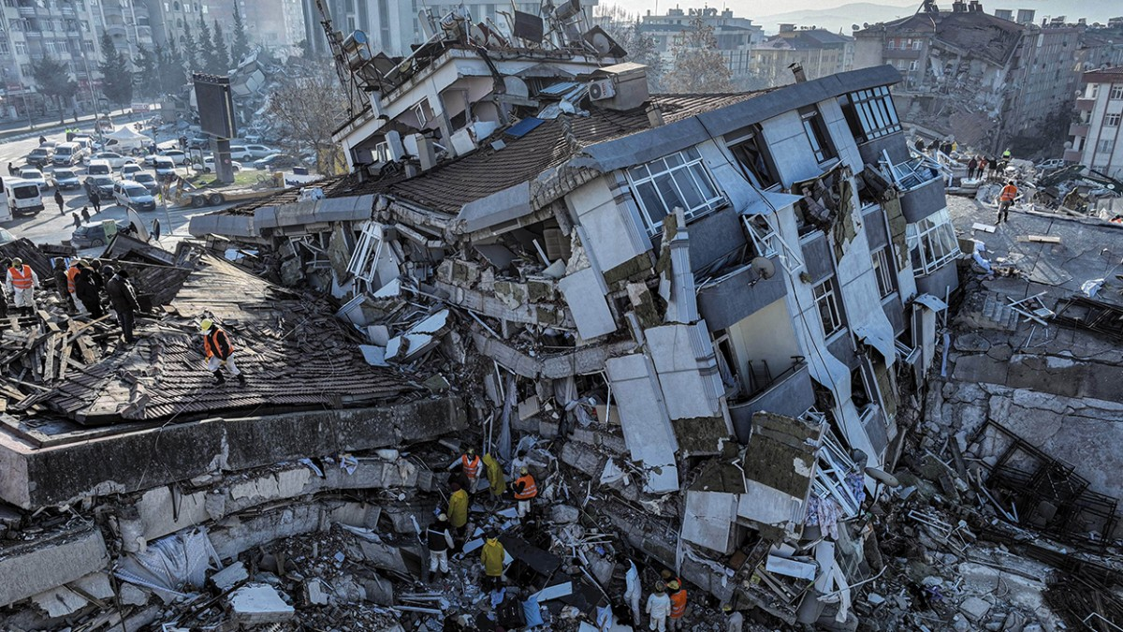


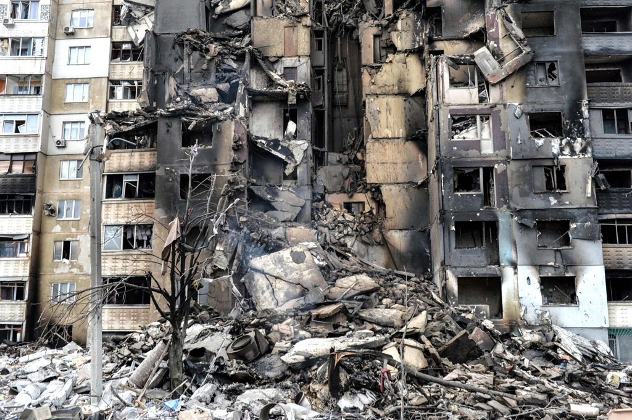
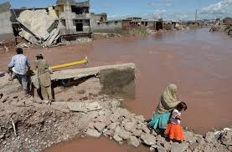


Slide 3
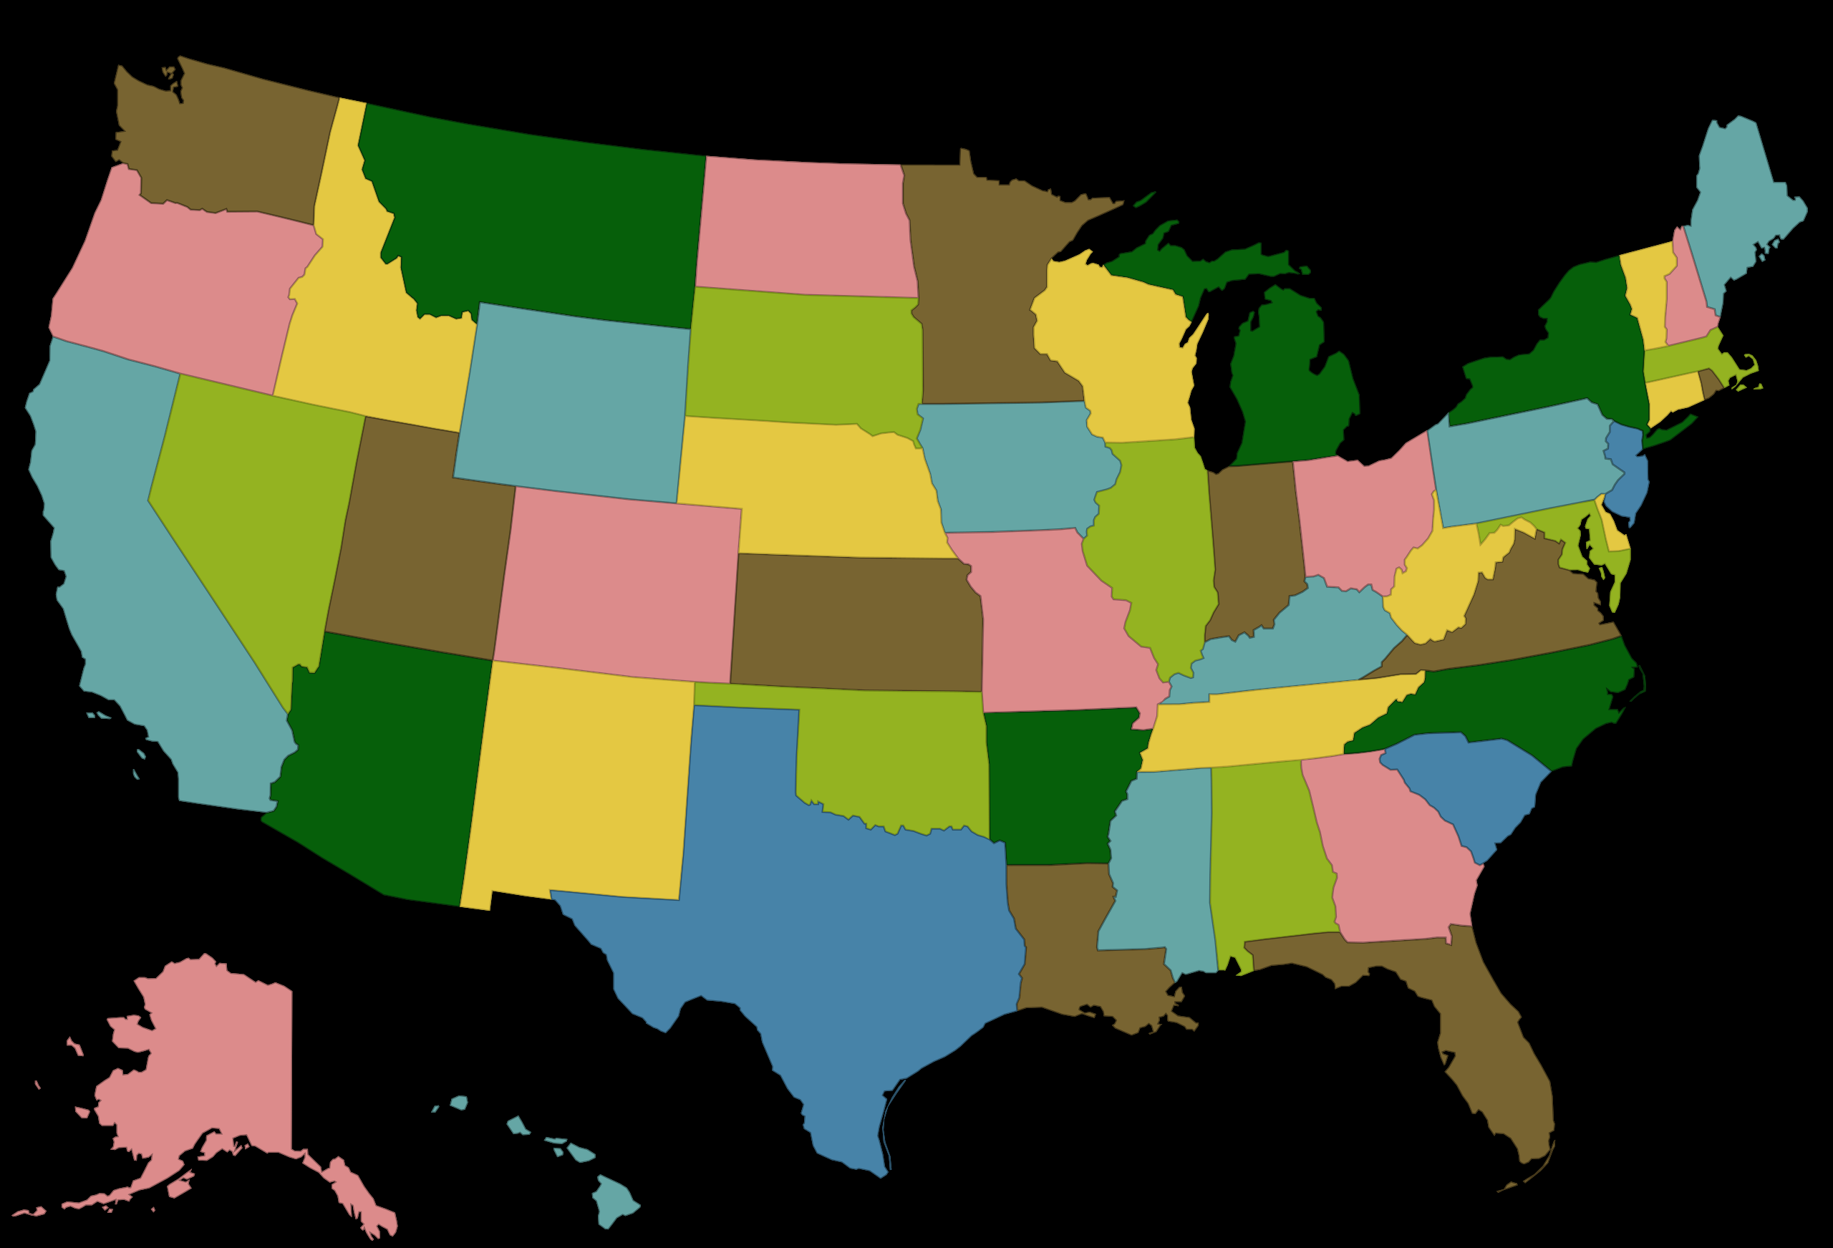






Slide 4
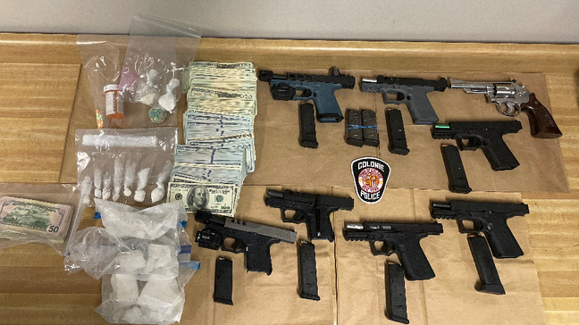
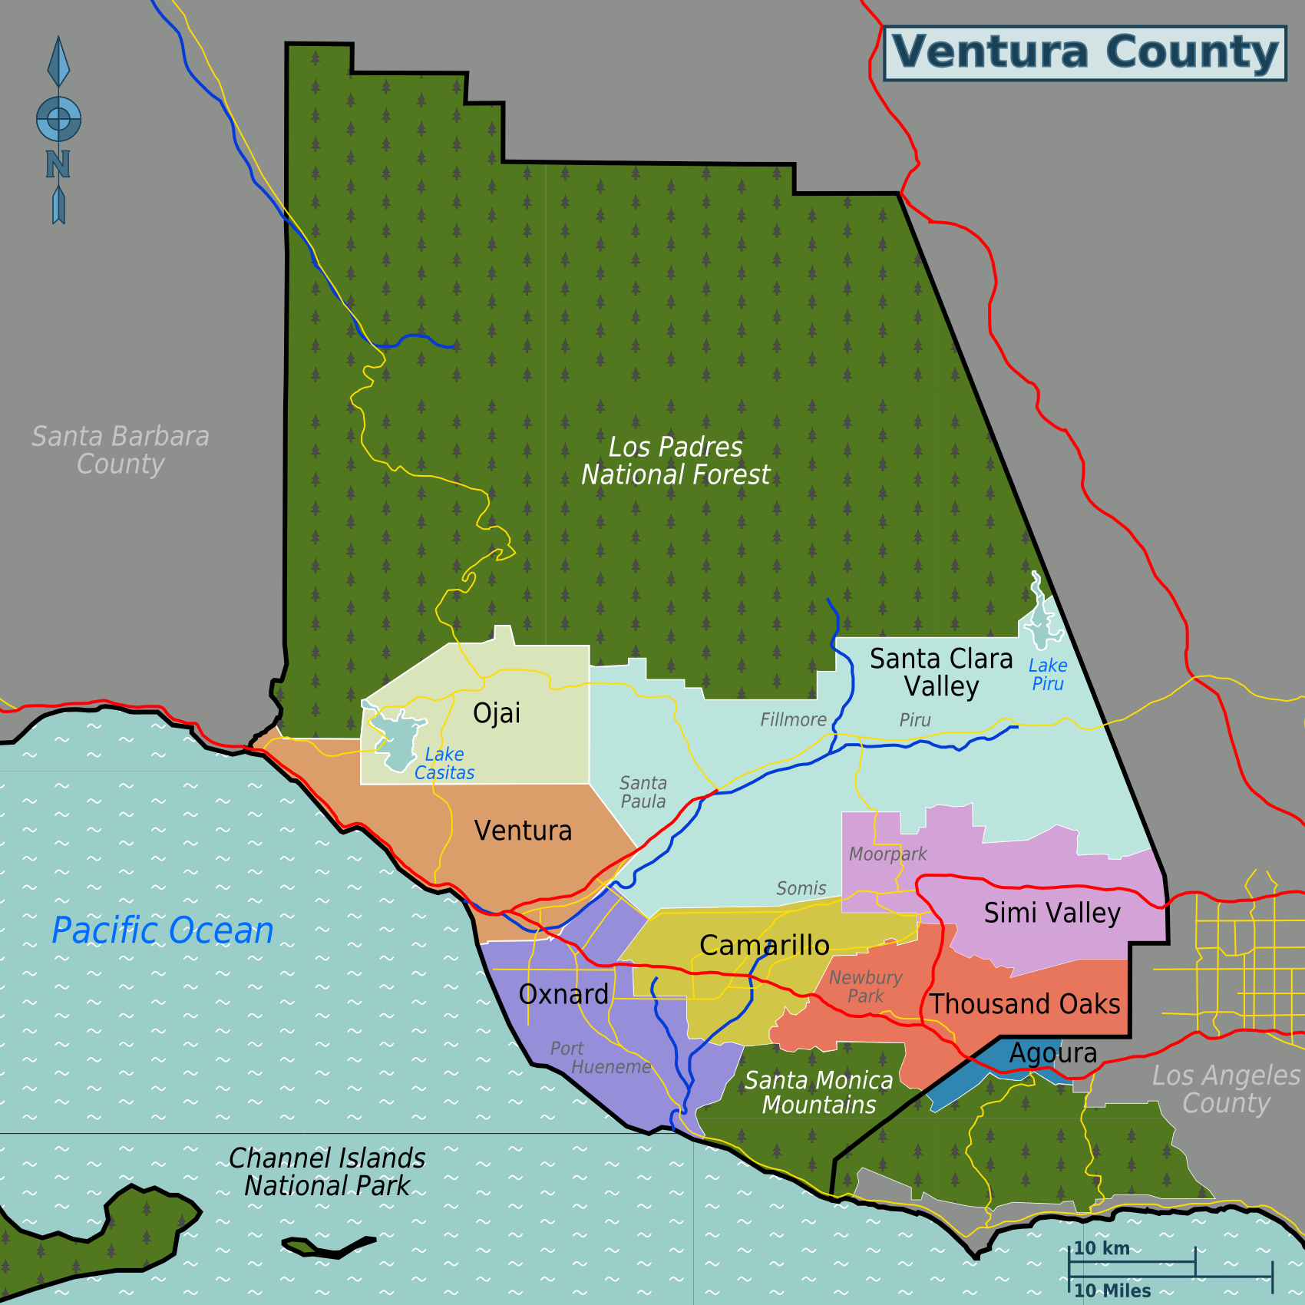



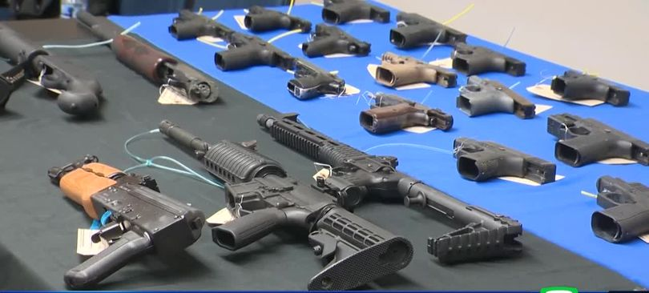

Slide 5
DISCOURAGEMENT IN THE CHURCH
Babes in Christ Fall Away before they have a chance to GROW!
2 Peter 2:20 “the latter end is worse for them than the beginning.”
Preachers STOP preaching the gospel!
Others cry “OH! FOR THE GOOD OLD DAYS!”
When was it ever EASY to be a CHRISTIAN?

Slide 6
DISCOURAGEMENT
Noah – preached for YEARS – only saved SEVEN OTHERS?
Moses – after bringing Israel out of Egypt came down from Mount Sinai only to find people worshiping golden calf!

Slide 7
DEFEAT
Ten spies who went into Canaan were discouraged and thus defeated!
Israel discouraged by MIGHT of Philistines and were DEFEATED until David stood up against Goliath!
Judas was discouraged when he saw what was happening to Jesus, result was defeat!
The “One Talent” man was discouraged and buried the amount entrusted to him – and so he was defeated!

Slide 8
Discouragement and defeatism
Some things which Christians become discouraged about:

Slide 9
Some things which Christians become discouraged about:
Trying to Win Souls!
Jesus calls upon us to TEACH the gospel to others
See the Faults, Weaknesses, Insincerity and Lukewarmness of professed Christians! 1 Peter 2:1,2
Seeming Slow Progress of the Local Church
Personal Failures – 1 Corinthians 15:58

Slide 10
WHY IS IT THAT CHRISTIANS BECOME DISCOURAGED?
Love For The Church And Brethren!
This is a GOOD attitude unless it OVERCOMES YOU and you suffer DEFEAT!
They have forgotten that HUMAN BEINGS are IMPERFECT!
2 Peter 1:5-10 “add together”
Hebrews 5:12-14 “by this time you ought to be teachers”

Slide 11
WHY IS IT THAT CHRISTIANS BECOME DISCOURAGED?
Tricks of SATAN!
REAL and CONSTANT THREAT! 1 Peter 5:8
Natural to be discouraged – Where is the man who has NEVER been discouraged?
The real DANGER is NOT in be DISCOURAGED!
The DANGER is in allowing discouragement to lead to DEFEAT!

Slide 12
WHY IS IT THAT SOME CHRISTIANS ARE DEFEATED?
Don’t Pray Like They Should! 1 Thessalonians 5:17
Problems look much SMALLER after PRAYER!
Failing to pray EXAGGERATES their size!
Some defeated because they don’t really believe GOD is ni control! Ephesians 3:20,21
When we BELEVE that GOD is ABLE to take care of us, we will not be DEFEATED by DISCOURAGMENT!

Slide 13
WHY IS IT THAT SOME CHRISTIANS ARE DEFEATED?
Never Learned The Meaning of Forgiveness!
Matthew 6:14,15 “if you do not forgive men their trespasses, neither will your heavenly Father forgive…”
Lack of FAITH!
Trust in GOD is the KEY to VICTORY over DEFEAT!
Trust in “SELF” more that God – Proverbs 3:5; Hebrews 13:6
Forget SALVATION is an INDIVIDUAL MATTER- Matthew 7:13,14

Slide 14
HOW CAN WE OVERCOME DISCOURAGEMENT AND DEFEATISM?
LIVE ON THE WORD OF GOD!
Matthew 4:4 "...`Man shall not live by bread alone, but by every word that proceeds from the mouth of God.’”
STUDY IT!
BELIEVE IT!
LEARN IT!
MEMORIZE IT!
LIVE IT!

Slide 15
We will NOT be discouraged unto DEFEAT if we ALWAYS look to the Bible for ANSWERS!
Men can be WRONG!
Even PREACHERS and ELDERS!
THE BIBLE
WORD OF GOD
IS TRUTH
John 17:17 “Sanctify them by Your truth. Your word is truth."

Slide 16
we must STAND FOR THE TRUTH!
Ephesians 5:11 “And have no fellowship with the unfruitful works of darkness, but rather expose {them}."
Jude 1:3 NKJV 3 Beloved, while I was very diligent to write to you concerning our common salvation, I found it necessary to write to you exhorting you to contend earnestly for the faith which was once for all delivered to the saints.”
NEVER means COMPROMISE!
The LORD LOVES US and has never done us any wrong!

Slide 17
not a SIN for you to be DISCOURAGED
GIVE UP and become DEFEATED may well cause the loss of our souls!
Revelation 21:8 “The cowardly…”
This describes the DEFEATED!
Recognize DISCOURAGEMENT and put it aside before it turns into DEFEAT!

